Slide 1
The Varied Forms, Potency, and Health Effects of Today’s Cannabis
Key Information for Prevention Practitioners to Share with Key Stakeholders and Communities

Slide 2
Acknowledgements
This slide deck was created in collaboration with the Prevention Technology Transfer Center Network Marijuana Risk Working Group, comprised of the following PTTC’s:
New England PTTC HHS Region 1
Great Lakes PTTC HHS Region 5
Pacific Southwest PTTC HHS Region 9
Northwest PTTC HHS Region 10
National American Indian and Alaska Native PTTC
National Hispanic and Latino PTTC
PTTC Network Coordinating Office
The Prevention Technology Transfer Center Network is funded by the Substance Abuse and Mental Health Services Administration.
Notes:
At the beginning of your presentation, provide brief acknowledgement of the PTTC Network Marijuana Risk Working Group which developed this slide deck. This slide lists the 7 centers serving on the work group.

Slide 3
Purpose
Improve implementation and delivery of effective substance use and misuse prevention interventions
Provide training and technical assistance services to the substance use and misuse prevention field
Tailored to meet the needs of recipients and the prevention field
Based in prevention science and use evidence-based and promising practices
Leverage the expertise and resources available through the alliances formed within and across the HHS regions and the PTTC Network.
Notes:
Provide a brief summary of the purpose of the PTTC Network, which funded and created this slide deck, and offers other prevention training and technical assistance services.
The purpose of the Prevention Technology Transfer Center, or PTTC, Network is to improve the implementation and delivery of effective substance use disorder prevention interventions.
The PTTCs provide training and technical assistance services to the substance use disorder prevention field.
Services are:
Tailored to meet the needs of the recipients in the field
Based in prevention science and use evidence-based and promising practices
And leverage the expertise and resources available through alliances within and across HHS regions and the PTTC Network.

Slide 4
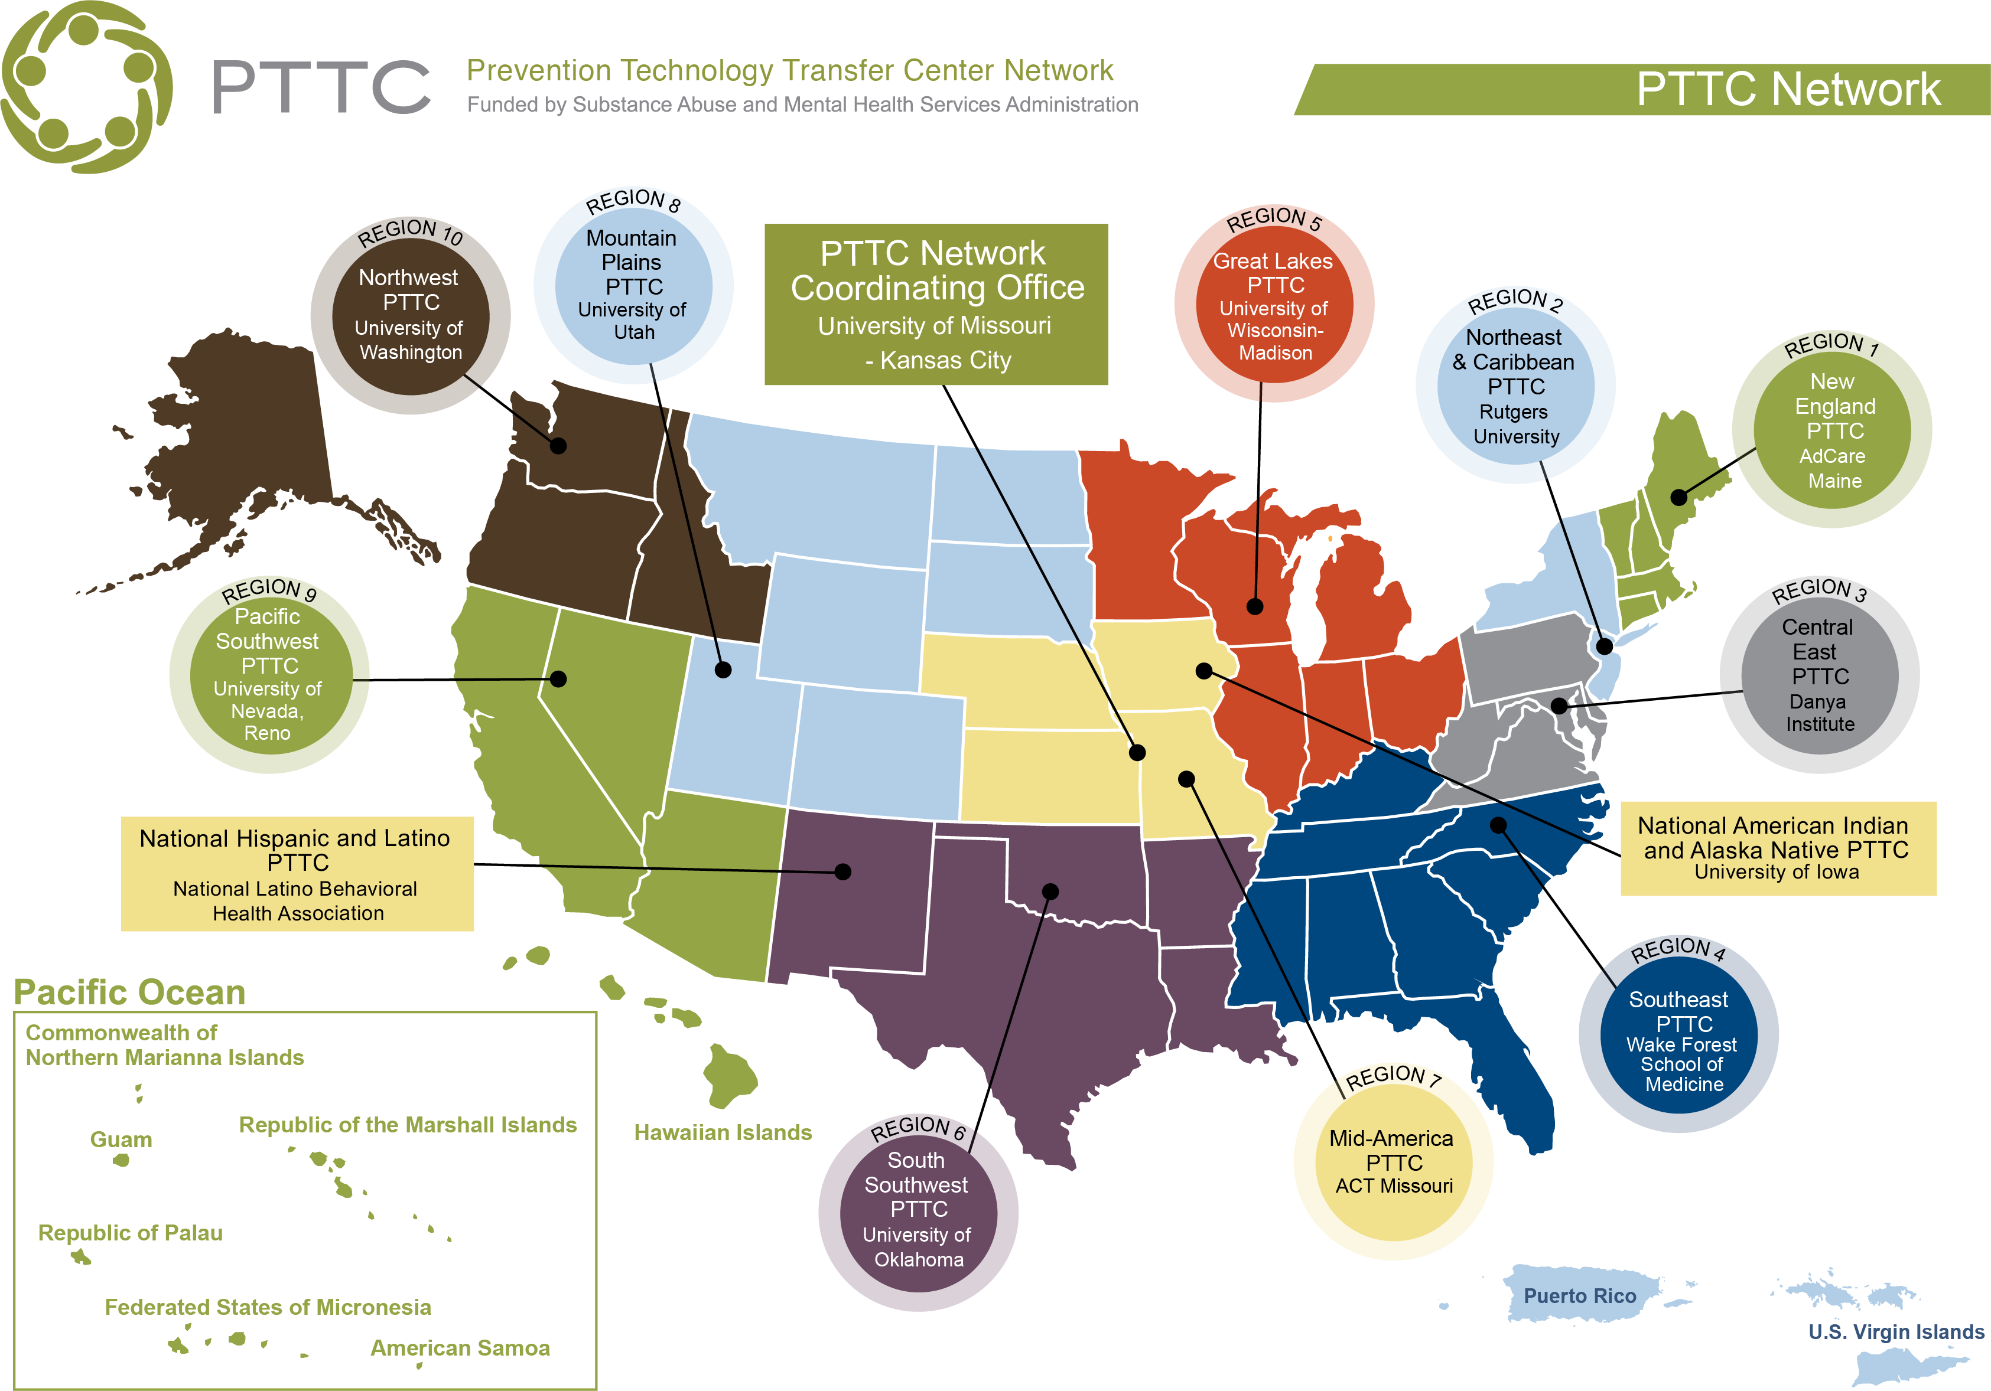
Notes:
The PTTC Network consists of 10 Regional Prevention Technology Transfer Centers, or PTTCs. You may want to highlight and mention the PTTC that serves your region.
The Network also consists of two national specialty centers:
National Hispanic and Latino PTTC
National American Indian and Alaska Native PTTC

Slide 5
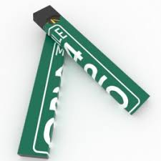
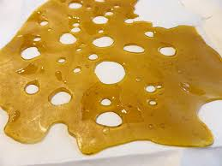
How has Marijuana use Changed over the past 50 years
Notes:
Introduction & Overview: setting the stage
The marijuana of today is much different from the 60’s and 70’s. It’s not just joints and bongs anymore.
As states are legalizing marijuana, it is leading to an increasing variety of products providing multiple options for consumption.
Meanwhile, the average potency of both state legal and illicit marijuana products continues to increase
This presentation will go through the many forms of marijuana available in states, and the different routes of administration.
While we still have much to research and learn, this presentation will cover what we’ve learned so far in the science with regards to some of the health impacts and public safety concerns associated with the different forms.

Slide 6
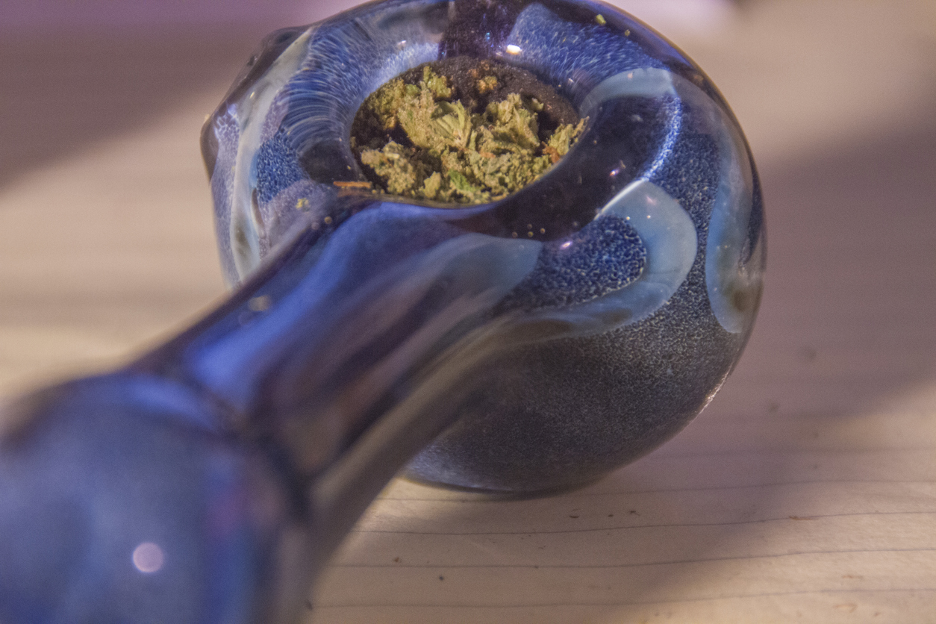
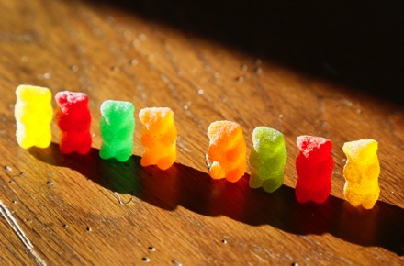
Common Routes of Administration
Inhalation
Smoked forms
ENDS & Vaping Devices
Marijuana Concentrates
Oral ingestion
Edibles
Tinctures
Topical administration
Notes:
Summarize for the audience the categories of marijuana forms you will be discussing. While some of these may not necessarily be new, as you will discuss later when you cover the section on potency, even the traditional products have changed over the years. It is important for your audience to be aware of the many different forms, especially those that can be discreet or undectable (e.g. sleek vaping devices or THC edibles that look like regular food)
There are 4 main categories that will be discussed:
Inhalation forms – combustible forms and vaping devices
Marijuana concentrates
Forms ingested orally, edibles and tinctures,
Topical forms – creams, salves, and so on

Slide 7
Smoked forms of marijuana
Notes:
The first category to be discussed is smoked forms of marijuana.

Slide 8
Smoked Forms of Marijuana
Smoking marijuana remains one of the most popular forms of marijuana consumption. Forms of smoked marijuana include:
Joints
Blunts
Pipes
Hookah pipes
Homemade delivery vessels
Notes:
While many more forms are available, smoked forms of marijuana remain one of the most common forms used. These are the most common forms of smoked marijuana, but it can vary from region to region, locality to locality in terms of popularity vs other forms. Smoked forms of marijuana have been and continue to be some of the more common and popular forms of marijuana consumption.
They will be familiar in multiple generations, although they are much different today in terms of average potencies.
Presenter Note: To encourage participation, you may want to poll or ask your audience what they see in their community around these forms. Are they common? Are parents aware of these?

Slide 9
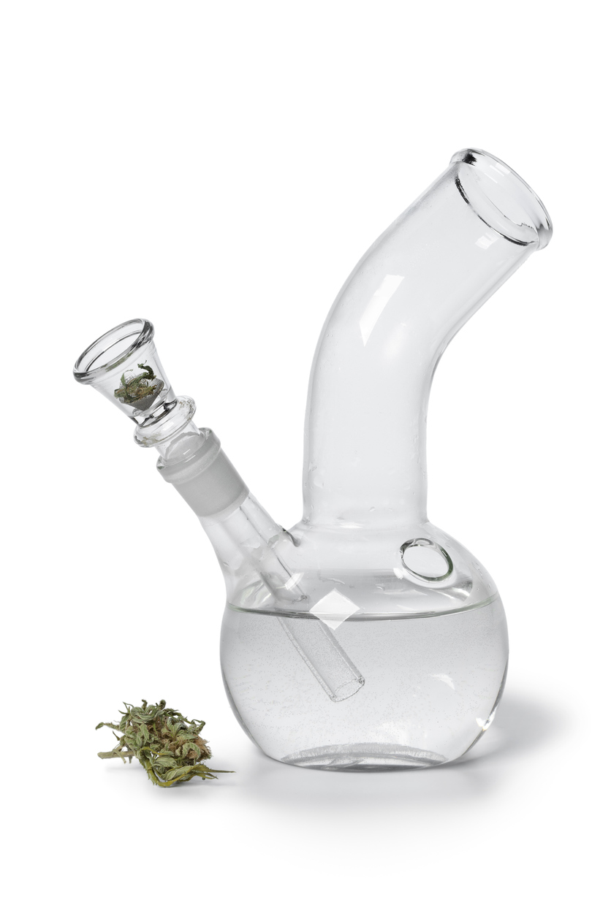
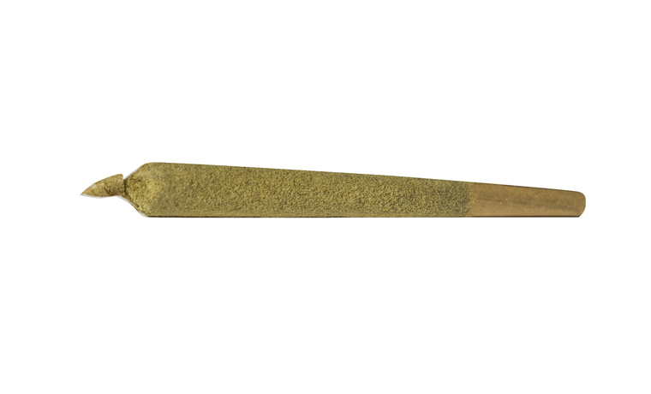
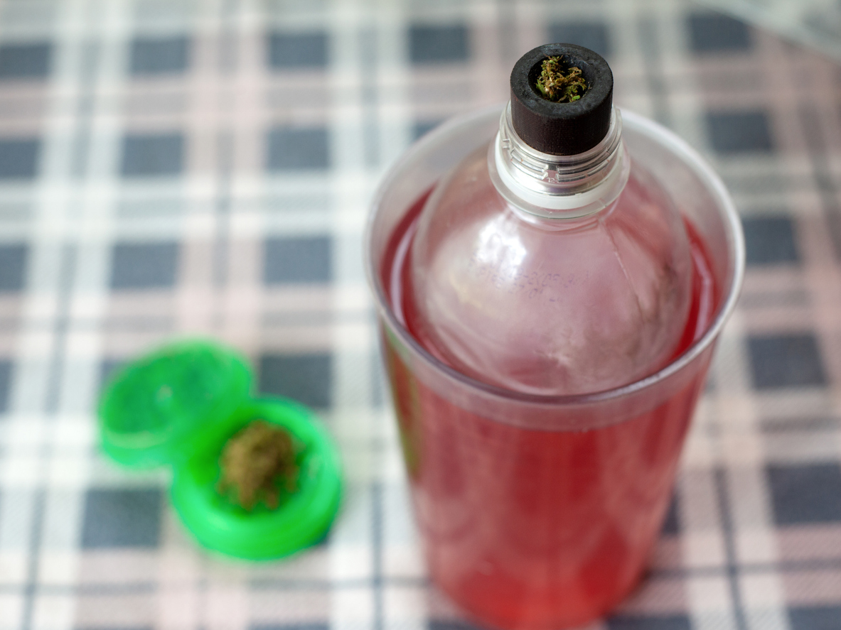
Breathing Problems
Marijuana smoke contains many of the same components as tobacco smoke, which can irritate the lungs.
Complications that can arise from smoking include:
Daily cough and phlegm
more frequent lung illnesses
longer recovery from illnesses such as colds
higher risk of lung infections
(National Academies of Sciences, Engineering, and Medicine, 2017).
Notes:
Acute and intermediate health affects of smoking various forms of marijuana are not dissimilar to those from smoking tobacco products. Scientific analysis of marijuana smokes reveal similar types of chemical is that can irritate lungs and impact the respiratory system. Research is ongoing to learn more about the health effects of smoked forms of marijuana, but from what we know so far, we know there can be negative impacts to the respiratory system.
Note for presenter: Consider your audience as to whether or not you show these and other images in the subsequent slides. The intended audiences for this presentation are adults, however, if you have a situation where you have a general audience that could include adolescents, you may want to use discretion and not include images so as to not unintentionally normalize.

Slide 10
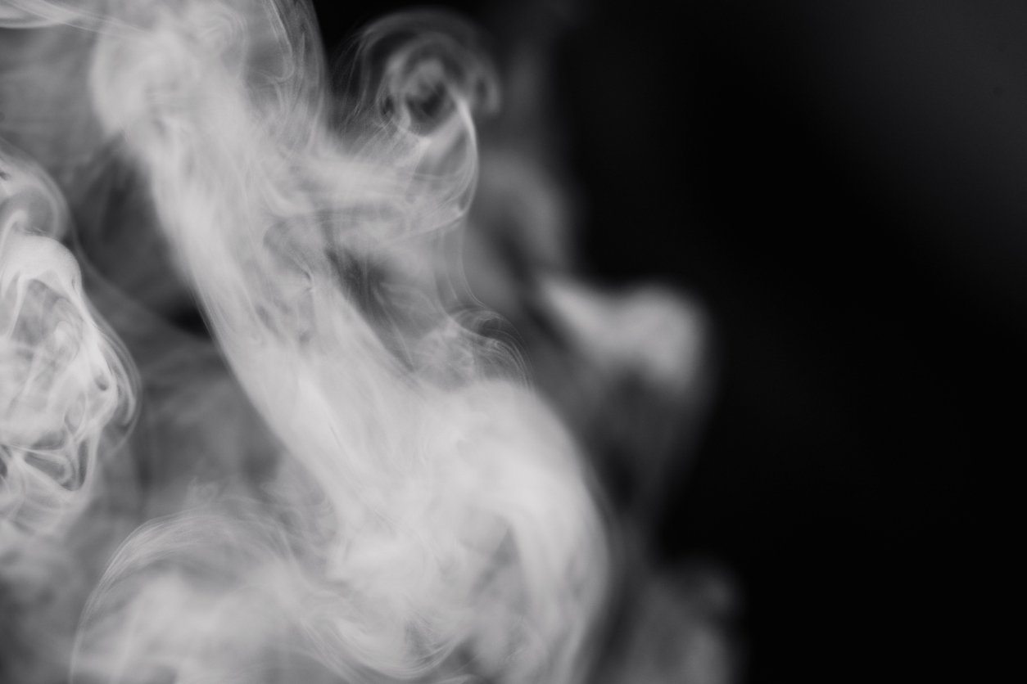
Marijuana smoke
Classified as a Carcinogen in California
At least 33 chemicals in tobacco and marijuana smoke are classified as carcinogens under CA prop 65:
Benzene
Benzopyrene
Arsenic
Formaldehyde
Mercury
Naphthalene
According to Tomar, Beumount, and Hsieh (2009),“In summary, there is some evidence from studies in humans that marijuana smoke is associated with increased cancer risk.”
Notes:
While research is ongoing, we do have some evidence looking at the composition of marijuana smoke, especially where it concerns potential risks to health. The State of California has classified marijuana smoke as a carcinogen. This was because research identified at least 33 chemicals in marijuana smoke that are known to be carcinogenic. These chemicals are also found in tobacco smoke.
Presenter Note: With this slide, we want to be clear we are not saying we have evidence that marijuana smoke causes cancer, that research is ongoing, however analysis reveals chemicals in marijuana smoke that are known to be carcinogenic. This is important and may be information many in the public are unaware of.
The bottom line is at a minimum we can say that marijuana smoke does contain chemicals known to be harmful to human health, and research is ongoing to further illuminate the health impacts.

Slide 11
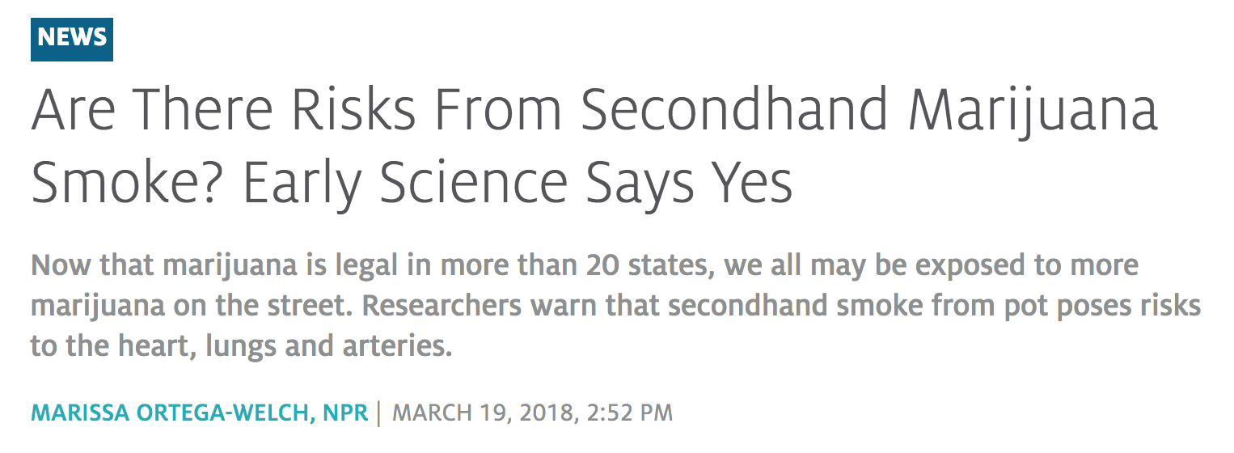
Second-Hand Smoke
According to Ortega-Welch (2018), “Springer demonstrated that, at least in rats, the same physiological effect occurs after inhaling secondhand smoke from marijuana. And, the arteries take 90 minutes to recover compared to the 30 minutes with cigarette smoke.”
Notes:
This is an example of emerging science looking at secondhand marijuana smoke. We are in the early stages of our understanding of the health impact to others from second hand smoke, as compared to what we know about tobacco smoke. However, early science is pointing to potential risks.
In terms of prevention, this would point to caution and following similar best practices to tobacco in terms of use of smoked forms of marijuana at home and how to minimize risks and harms to others. We want to encourage similar practices such as smoking outside instead of inside the home where second hand and third hand smoke could potentially impact other family members.

Slide 12
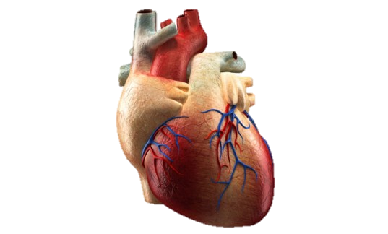
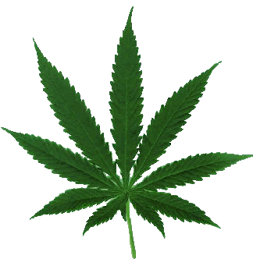
Effects on the Heart
Marijuana can cause the heart rate to increase by 20 to 50 beats per minute. This increase can last for hours after use has stopped.
Increased heart rates can be even greater if other drugs are used at the same time.
(Mittleman, M., et.al. (2001).
Notes:
A lot of the public conversation about marijuana and health (rightfully so) focuses on brain development, impairment, addiction, and effects on lungs. Meanwhile, emerging science is starting to describe the effects of marijuana on the heart. While there is much more to learn, we know enough to warrant caution and discretion, in particular, to those at risk for heart disease.
Is this something your audience was aware of, in terms of effects on the heart?

Slide 13
Nausea and Vomiting
People who use marijuana regularly and over a long length of time can be at risk of developing Cannabinoid Hyperemesis Syndrome aka ”Cyclical Vomiting Syndrome”
Symptoms include:
severe nausea
vomiting
dehydration
Cases can be severe enough to require emergency medical services (Galli J., Sawaya R., and Friedenberg F., 2011)
Notes:
In this slide, we describe Cannabinoid Hyperemesis Syndrome or “Cyclical Vomiting Syndrome”. This condition can produce some particularly unpleasant symptoms and often require emergency medical services. How severe the symptoms will be can be impacted by many factors, such as the potency of the product being used, the route of administration, and individual physiology.
These symptoms can also occur through the use of other forms of marijuana, especially any forms with high THC content, such as edibles and concentrates.

Slide 14
ENDS/vaping devices
Notes:
The next category to be covered are ENDS or Electronic Nicotine Delivery Systems, aka vaping devices.
Note to Presenter: In this section, you may want to reference what is happening in your state or community around the current outbreak of pulmonary disease related to ENDS and vaping devices. Perhaps you will want to create a handout, or your own slide, talking about the data or referencing any health advisories that have been issued in your state.

Slide 15
Electronic Nicotine Delivery Systems or Vape Pens
Electronic Nicotine Deliver Systems (ENDS) aka Vaping Devices, are electronic devices used for the inhalation of vaporized solutions, such as those containing nicotine.
ENDS are also commonly used with solutions containing THC.
Vaping devices and THC vaping solutions are often sold at marijuana dispensaries.
Notes:
Note for presenters: Terminology for these devices varies quite a bit and may look different from region to region. ENDS tends to be the technical term used often in public health, but consider using the terminology that will most resonate or connect with your audience. You should not alter slides, but adapt in the oral delivery of your presentation.
To encourage participation, you may want to ask your audience if they are aware of these devices. If your audience works with parents, are parents aware of these devices? Are the local schools experiencing issues with these? Employers?

Slide 16
Other common names for ENDS products
e-cigs
Vapes
E-hookahs
Vape pens
Mods
Tanks
Usage of these devices is commonly referred to as: “vaping”, “juuling”, or “dabbing”
Notes:
These are some of the more common terms, but there may be other terms for these devices that are particular to your region.
Ask you audience:
Are there certain slang terms that are popular with local youth?
Young adults and/or adults?
What are the educators hearing?
What are parents hearing?

Slide 17
“VAPING”: Causes the oils in the extract to heat up to the point where they are released as an aerosol
Notes:
The common misconception is that these devices are emitting a benign water vaport.
However, It is important for us to be scientifically accurate in describing the emission of ENDs devices as aerosols vs vapor.
Using the term “vapor” is both incorrect, but can normalize these devices as benign and harmless.
The definition of aerosol from Dictionary.com: -a colloidal suspension of particles dispersed in air or gas.
This, scientifically, is what is being emitted by these devices.

Slide 18
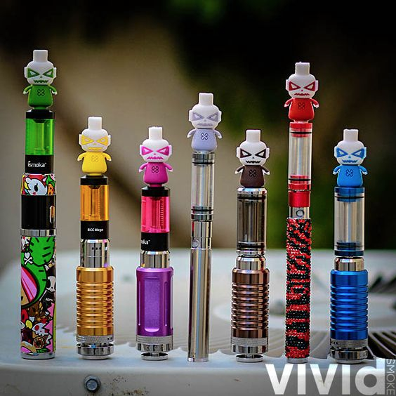
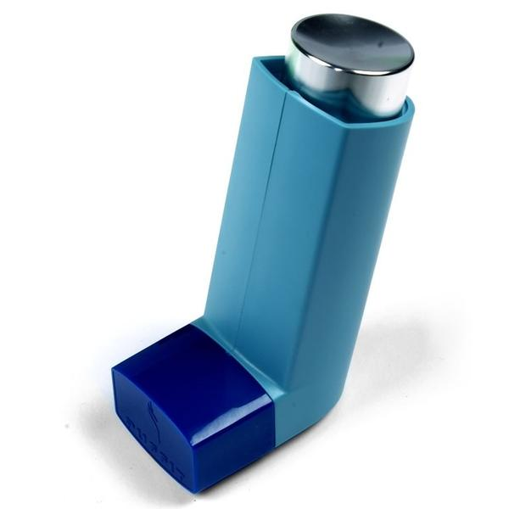
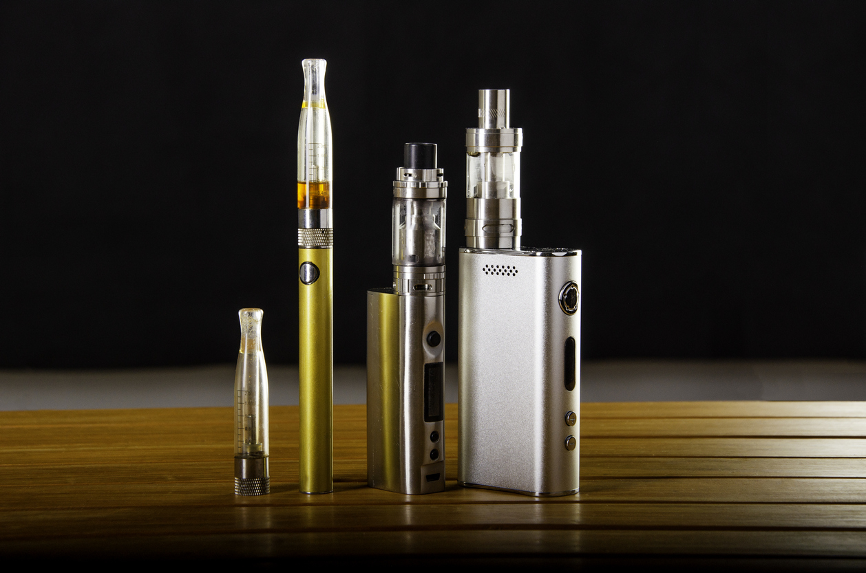
There are many artfully concealed vaping devices on the market as well as the openly obvious devices.
Notes:
The point of this slide is to demonstrate to your audience a couple of different trends with vaping devices.
In some cases, they are made to attract attention, such as the image on the left.
In other cases, they are made to be quite discreet such as the middle image of a device designed to look like an asthma inhaler.
In a couple of slides we will see another example, the JUUL devices made to be very sleek and discreet, and easily concealed.
Has your audience seen other examples of either very flashy or very discreet vaping devices?

Slide 19
How ENDS are used
Devices are commonly used with cartridges that include a solution that may contain nicotine, THC, or e-juices.
“Dripping” involves dropping the solution directly onto the heated coils of the device which can result in a high concentration of the given compound
“Dabbing” refers to the usage of highly potent solutions with ENDS devices, such as highly potent THC solutions.
Notes:
This slide describes how ENDS or vaping devices are typically used, including common slang terms for different types of use:
”Dripping” or dropping the solution directly onto the heated coils to provide a highly concentrated aerosol.
“Dabbing” or usage of high potency THC solutions.

Slide 20
ENDS Aerosols
There can be a common misperception that the aerosols generated by ENDS are safe, or safer than traditional nicotine products because it isn’t smoke being produced (U.S. Surgeon General, 2018).
Analysis of these aerosols have found potentially harmful substances such as volatile organic compounds, heavy metals (e.g. tin, lead, and nickel), and chemicals known to cause cancer (U.S. Surgeon General, 2018).
Aerosols may also contain ultrafine particulates that can settle and accumulate in lungs leading to significant respiratory difficulties and symptoms (U.S. Surgeon General, 2018).
Notes:
This slide provides information on the nature of the aerosols generated by ENDS or vaping devices.
Contrary to what may be believed, the aerosols are not benign water vapors.
They have been analyzed and found to contain volatile organic compounds, chemicals known to cause cancer, heavy metals such as tin or lead.
The aerosols can also contain ultrafine particles that settle in the lungs and cause or contribute to respiratory difficulties and pulmonary illnesses.
This ties into the current, urgent public health crisis related to vaping that is occurring in many of our states.

Slide 21
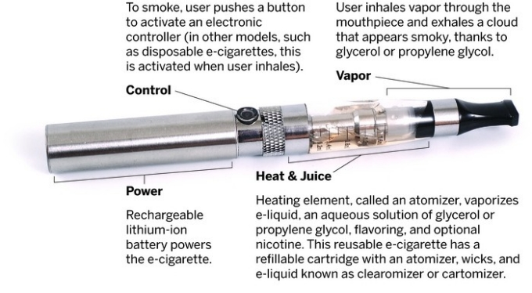
Anatomy of a Vape Pen
Notes:
With this slide, walk your participants through how a vaping device works.
Devices may look very different, but they all function in very similar ways.

Slide 22
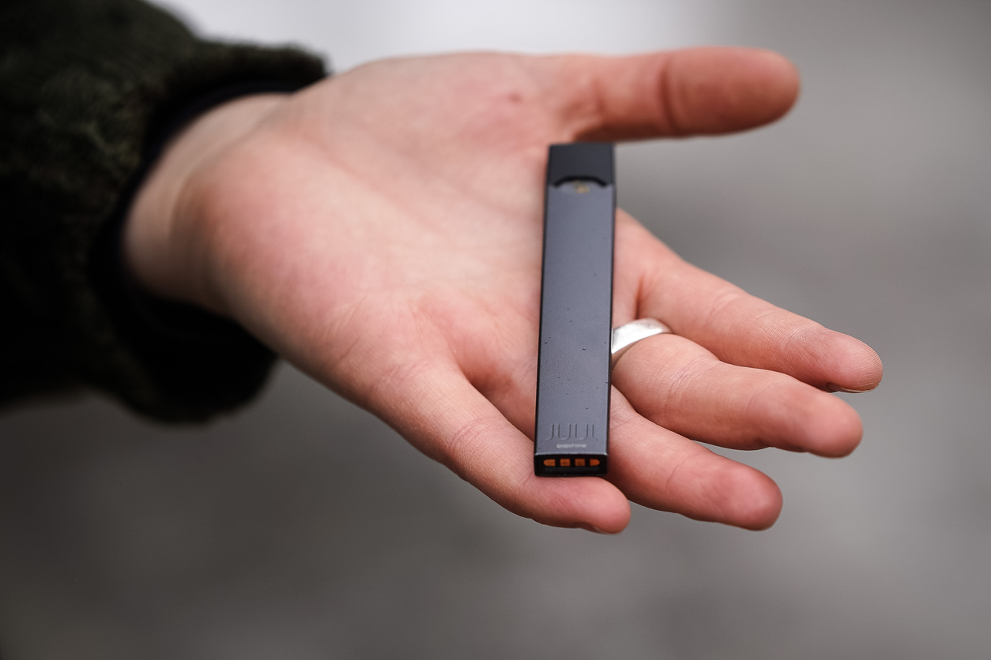
JUUL
Sleek and resembles a flash drive
Rechargeable via USB
Aerosol cloud dissipates very quickly
Cartridges may contain e-juice, nicotine, or THC
Cartridges are highly concentrated whether it is nicotine or THC
Notes:
To encourage participation, ask your audience if they’ve heard of JUUL devices.
Use this slide to describe what JUUL devices are.

Slide 23
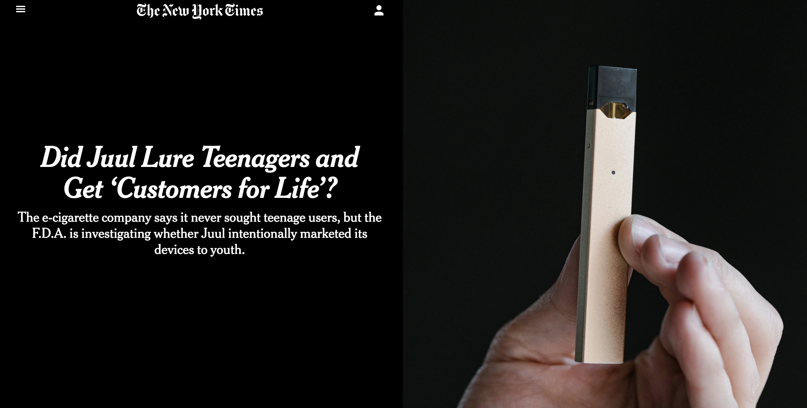
Notes:
One of the issues with JUUL has been marketing and appealing to youth.
This New York Times article takes an in depth look at the marketing practices of JUUL and how they may have contributed to the growing use of their devices amongst youth.
Here is a link to the article. You may want to print out copies to provide to their audience, or give them the link to read later on their own.
https://www.nytimes.com/2018/08/27/science/juul-vaping-teen-marketing.html

Slide 24
CDC Health Advisory
The CDC issued a Health Advisory for ENDS products on August 30th, 2019, and is providing regular updates.
In response to an outbreak of over 805 possible cases of pulmonary disease that appeared to be associated with the usage of ENDS devices (CDC, 2019).
The CDC is conducting epidemiological investigations to better understand the etiology of these cases.
Many patients reported using ENDS products containing cannabinoids including THC and CBD (CDC, 2019).
Notes:
Here is where you can provide some focused discussion on the current public health crisis related to vaping.
This slide is a summary of the CDC Health Advisory issued in the wake of the current vaping crisis.
As of the production of this slide deck, the number of suspected cases is up to 805, with 14 deaths linked to vaping devices.
This is likely to be a very fluid and rapidly developing issue so you may want to consult with the CDC website to get the latest numbers.
You can also consult with this page on the PTTC website, for the latest national numbers related to this crisis: https://pttcnetwork.org/centers/new-england-pttc/vaping-resources-and-information
You may also want to research and provide data from your state and/or community.

Slide 25
Reported Health Effects
Cough
Shortness of breath
Chest pain
Nausea
Vomiting
Diarrhea
Fatigue
Fever
Weight loss
Notes:
According to the CDC (2019), the following health effects of vaping are cough, shortness of breath, chest pain, nausea, vomiting, diarrhea, fatigue, fever, and weight loss.
If you have state public health representatives or others working on the ground in your state to address this, you may want to invite them to share any updated information they have around this.

Slide 26
Marijuana concentrates
Notes:
In this next section, we will discuss the more potent forms of marijuana products, the concentrates.

Slide 27
Marijuana Concentrates
Made by extracting THC from marijuana by using solvents such as butane, which are highly flammable. (DEA, 2019)
Resulting product is a sticky, or wax-like mass that can look similar in consistency to honey, butter, or ear wax. (DEA, 2019)
Some products may have more of a brittle-like consistency, and can be commonly referred to as ‘shatter.’ (DEA, 2019)
Final products can have potencies of 40 – 80% THC. Users may have a high that lasts up to 24 hours. (DEA, 2019)
Concentrates are legal in states that have legalized marijuana and are sold in retail marijuana dispensaries.
Notes:
Presenter’s note: To make your presentation more engaging - You may want to consider orally covering these bullet points while showing the next slide which has pictures to show what concentrates look like. You can simply copy and paste these bullets into the presenter notes of the next slide.
However, if you provide this as a handout, this slide will be important so they can have the information on hand.
The information on this slide comes from these two sites:
Get Smart About Drugs: A DEA Resource for Parents, Educators, and Caregivers - https://www.getsmartaboutdrugs.gov/content/what-you-should-know-about-marijuana-concentrates-honey-butane-oil
Get the Facts About Drugs - Just Think Twice (DEA): https://www.justthinktwice.gov/facts-about-marijuana-concentrates

Slide 28
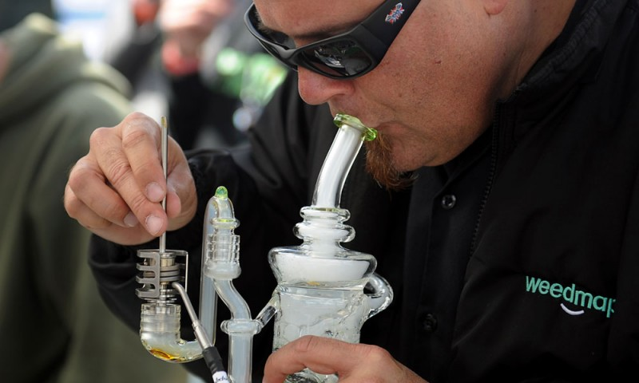
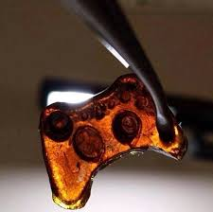
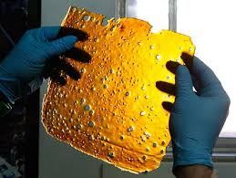
Notes:
Images showing a sampling of what waxes/shatter/concentrates can look like.
These products can have the waxy consistency as the image in the upper left, or a more brittle, glass-like consistency such as the “shatter” in the lower right.
Lower left is an example of how they can be fashioned to look like common items such as video game controllers.
Concentrates can be used in vape pens or devices such as an oil rig pictured in the upper right.

Slide 29
How Concentrates Are Used
Concentrates can be used in various ways: (DEA, 2019)
Consumed orally as infused in edible or drinkable products
Used in a e-cigarette or vaping device
Smoked using water or oil pipes, also known as oil rigs
Using concentrates in a vaping device or pipe is often referred to as “dabbing”
Notes:
The information on this slide comes from this site:
Get Smart About Drugs: A DEA Resource for Parents, Educators, and Caregivers - https://www.getsmartaboutdrugs.gov/content/what-you-should-know-about-marijuana-concentrates-honey-butane-oil

Slide 30
Hazards of Home Production of Concentrates
Despite availability of concentrates in dispensaries, amateur production of concentrates persists, including in legalized states (Al-Zouabi, I., Stogner, J., Miller, B., and Lane, E., 2018; Rosenthal and Downs, 2014).
Amateur concentrate production often takes place in settings such as garages, tool sheds, and vacant homes (Al-Zouabi, I., Stogner, J., Miller, B., and Lane, E., 2018; Rosenthal and Downs, 2014).
Butane removed from the products can build up in these spaces and then be ignited by sparks or static electricity, causing explosions (Al-Zouabi, I., Stogner, J., Miller, B., and Lane, E., 2018; Rosenthal and Downs, 2014).
Amateur home production of concentrates creates public safety hazards to the manufacturer and surrounding properties (Al-Zouabi, I., Stogner, J., Miller, B., and Lane, E., 2018; Rosenthal and Downs, 2014).
Notes:
In this slide we are covering some of the known safety hazards of home production of concentrates. For a more engaging presentation, don’t read the bullet points verbatim (but this information will be very valuable to your audience as a handout) here are the points being covered:
Amateur production of concentrates continues unabated even after legalization and when concentrates are available for purchase in dispensaries
Some common settings for amateur concentrate production include: garages, tool sheds, and vacant homes. (this is something important for law enforcement and city/town leaders to be aware of)
The butane or other volatile solvents used can build up like any other gas and can be ignited by sparks from static electricity which can lead to explosions
It then follows that this causes significant safety risks to surrounding properties. (This would be important information for realtors and home buyers to be aware of)

Slide 31
oral consumption: edibles & tinctures
Notes:
The next section you are going to cover with your audience is oral consumption: Edibles and Tinctures.

Slide 32
Marijuana Edibles
Due to it’s fat-soluble properties, THC can be infused into many kinds of edible products. (Priyamvada Sharma, PhD, et al. 2012)
Edible products can include candies, baked goods like cookies and brownies, and drinkable products.
THC can also be infused in butter and cooking oils allowing it to be incorporated into many other types of dishes such as pasta, proteins, and more.
Notes:
In many legalized states, marijuana edibles are one of the fastest growing segments of the commercial marijuana markets. (This article talks about that, which may be helpful for your background as a presenter: https://www.motherjones.com/food/2018/03/the-edibles-market-is-exploding-you-can-bet-big-corporations-are-watching/)
In this slide, we describe how THC is a fat soluble molecule, which is why there is such a wide variety of edible products that can be created. Because it is fat soluble, it can be infused into butters and cooking oils which are used in many types of food products. In a couple of slides you will show your audience some examples, but you should stress this is just a small sampling of what is available in the state commercial marijuana markets.

Slide 33
Delayed Effects of Marijuana Edibles
THC hits the bloodstream differently when marijuana is being consumed as an edible vs smoked or vaporized forms (NIH, 2019).
Because edibles are processed through the stomach and liver, the onset of psychoactive effects can be anywhere from 1 to 3 hours after consumption (NIH, 2019).
This poses additional risks for impaired driving, particularly amongst youth and new adult users of marijuana who are unaware of the delayed onset.
Notes:
One thing that is very different about marijuana that is consumed orally is the delay in the psychoactive effects. This is because these products are processed through the stomach, as opposed to a product that is inhaled which is processed through the lungs, and therefore hits the bloodstream much faster. The delayed effect for edibles can be anywhere from 1 to 3 hours. As your audience may be able to imagine, this can have significant ramifications for operating a motor vehicle, operating heavy machinery at work, etc, especially for novice users.

Slide 34
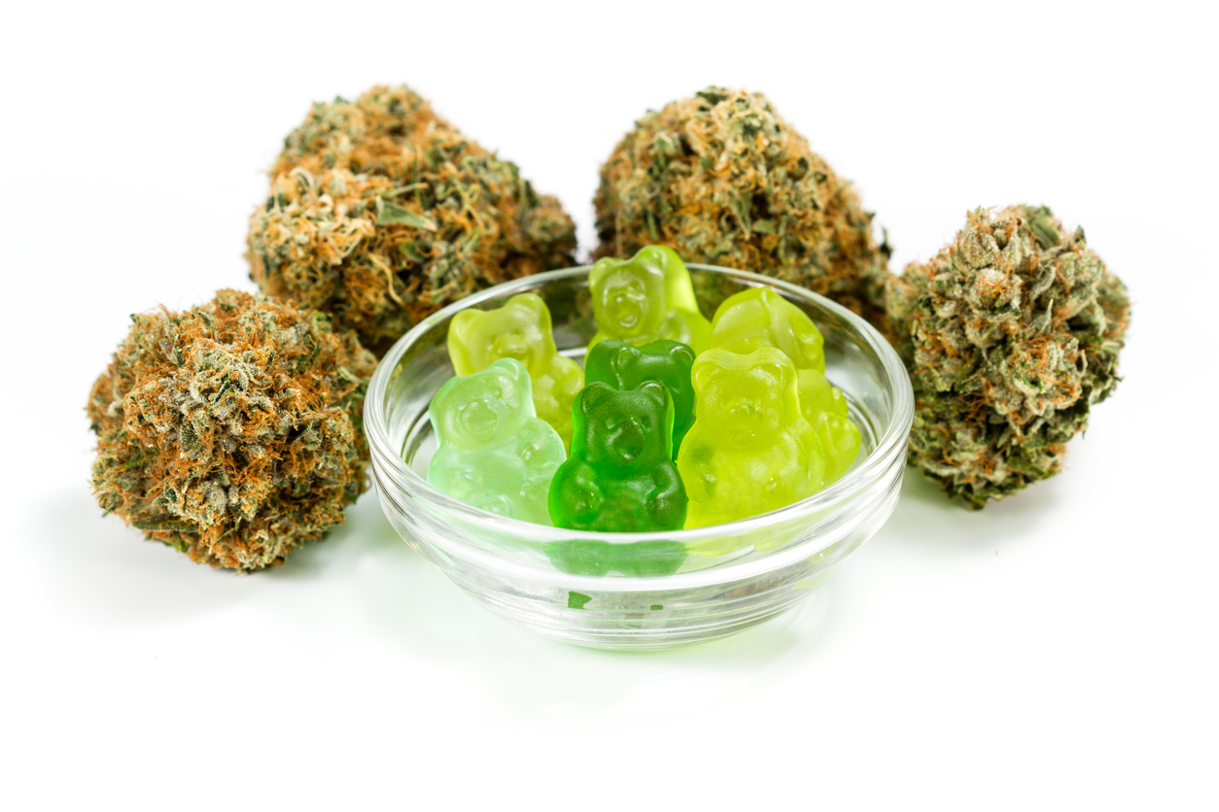
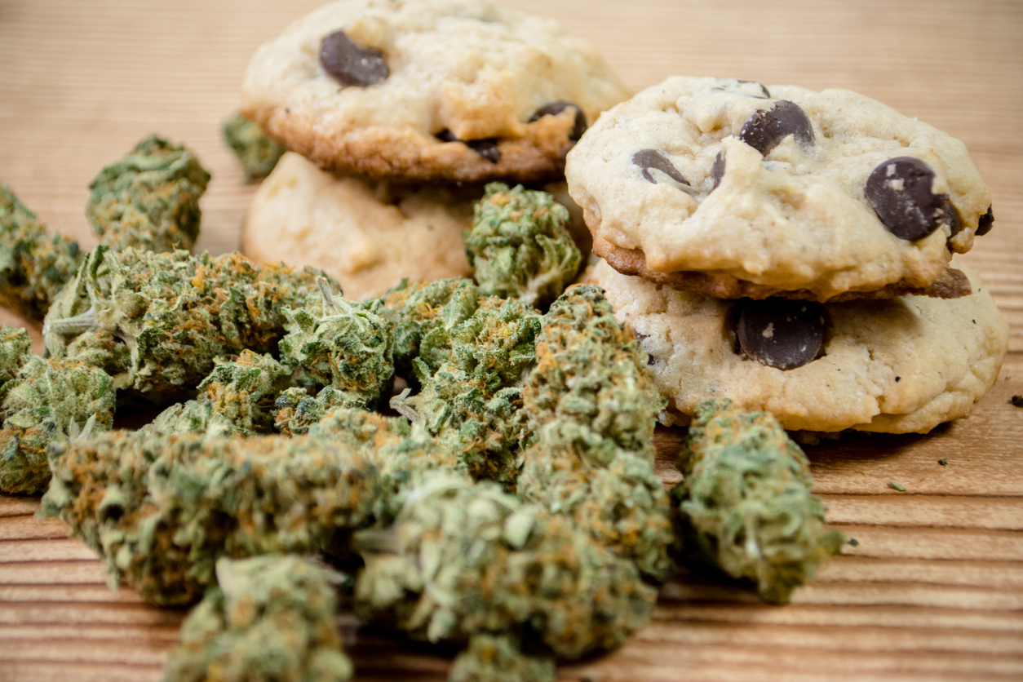
Marijuana Edibles
Notes:
In this slide we see some pictures demonstrating the different types of marijuana edibles that are produced and consumed:
Upper Left: THC gummy bears,
Upper Right: THC gummy worms,
Lower Left: THC chocolate chip cookies
Lower Right: Edibles with THC-infused cream cheese

Slide 35
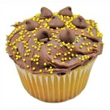
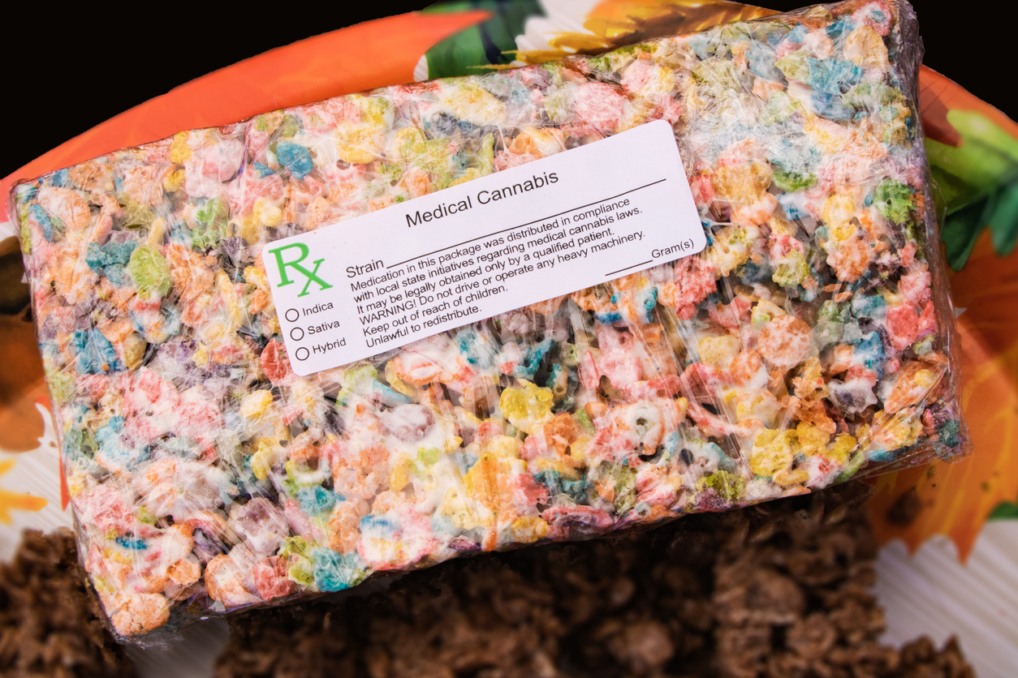
Many Edible Products Will Appeal to Youth
Notes:
In this slide we want to discuss how these products, by their very nature, can appeal to children:
Upper Left: A THC-infused cupcake
Upper Right: THC-infused lollipops
Lower Left: THC-infused Easter cookies
Lower Right: THC-infused “Fruity Pebbles” treat. (Like a Rice Krispie’s treat, made with marshmallow where the marshmallow has been infused with THC)
Discuss with your audience how the appeal and forms can pose risks to children and adolescents.
With young children, we need to be concerned about them seeing a THC gummy bear out of the package and thinking it’s a regular gummy bear when it really is a potent, adult dose of THC.
With adolescents, we need to be concerned about how a THC fruity pebbles bar is going to be appealing to try.
We also need to be concerned with potency. The trend continues to be upward in terms of average potencies of THC products, this is true for edibles.
Edible products can also be unpredictable, particularly baked goods. THC is often present through a THC-infused butter used to bake the product. The THC may not always be evenly distributed throughout the product (e.g. a cookie or brownie), this means there will be different potencies in different portions of the product.

Slide 36
(Shop window with cannabis products. Photo by nickolette)
Notes:
In this slide we see an example of what a marijuana dispensary store front can look like. In this photo, we see a display with many types of edibles such as lollipops, gummy products, chocolate candies, and THC-infused drinks and soda.
Discuss with your audience how this might contribute to youth issues (e.g. normalization)
To engage with your audience: if you are in a state that has legal marijuana dispensaries, has your audience seen any of these? If they have, what have they seen in terms of marketing, product display, and so on in the storefronts?

Slide 37
Notes:
In this image, 4 of the gummy bears contain THC, 4 don’t, can the audience spot the difference? Could a 5 year old? (It’s the ones on the right)
Challenges for parents and caretakers: Out of the package, edible products are often indistinguishable from non-marijuana food products.
Role for prevention: If edibles are going to be in a home with children, adults need to be educated on importance of secure storage and monitoring.

Slide 38
Study: Edible pot sickens more kids
“The mean rate of marijuana-related visits to the children's hospital increased from 1.2 per 100 000 population 2 years prior to legalization to 2.3 per 100,000 population 2 years after legalization (P = .02). Known marijuana products involved in the exposure included 30 infused edibles (48%).” (JAMA Pediatrics, 2016)
Notes:
This report encapsulates a public health issue that emerged in Colorado after legalization. Namely the issue of children and marijuana poisonings, many caused by THC edibles. This study highlights the importance of strong policies around marketing, labeling, and packaging.
It also highlights the importance of safe and secure storage and monitoring.
Note for presenter: This is where you might want to interject a small discussion about the importance of parental modeling and monitoring, as risk and protective factors for youth substance use. It applies in this case to marijuana but other substances in the home that are being consumed by adults.
Are these products securely stored and monitored?
Are adults consuming in front of children? Are adults consuming with children?
How are adults talking about it? Are they unintentionally normalizing or glamorizing? Do they link their consumption with having a hard day?

Slide 39
Tinctures
Alcohol-based cannabis extracts.
Products are manufactured with varying THC potencies
Used by dropping under the tongue.
Also used by adding to food or beverages
Notes:
Tinctures may not get as much press as smoked forms, vaped forms, or edibles, but there is a sizable market. These products are available in adult-use and medical marijuana dispensaries. These products can be very potent with high THC content. Tinctures can often be added to food, and would have the same delayed-effect that edibles have. Bottles are often very small and easy to conceal.

Slide 40
Topical applications
Lotions, salves, oils, or sprays infused with cannabinoids, including THC and CBD.
Can also be manufactured in the form of transdermal patches.
Lotions, salve, oils, and sprays typically don’t reach the bloodstream and thus don’t have psychoactive effects.
Transdermal patches can reach the bloodstream and if containing THC can potentially have psychoactive effects.
Notes:
Due to the nature of the product, it is not as commonly used for the purposes of the psychoactive effect. However, it is still important to be aware of these forms of cannabinoids. For example, transdermal patches can have psychoactive effects because THC is more likely to be absorbed and passed into the bloodstream.

Slide 41
Potency
Notes:
Potency is the important subtext of all the forms of marijuana. In this last section you will discuss the trends in potency and why it matters.

Slide 42
Today’s Marijuana and Potency
According to Chandra, et.al.(2010), “Today’s marijuana is far more potent: The average THC content in marijuana has risen dramatically over the past 10 years from under 8.9% in 2008 to more than 17.1% in 2017.” (p. 1)
The 8.9% in 2008 was already more than double the 4% from 1983 (Chandra, et.al., 2010).
Greater marijuana potency means a smaller amount can make someone higher, faster- and perhaps far more intoxicated than they can handle.
Notes:
The marijuana of today is much more potent than what was available in the 60’s and 70’s. This has important ramifications for health effects on adolescents and adults alike.

Slide 43
Notes:
This chart shows the trend in the average THC potency of marijuana products since the 1980’s. This comes from the University of Mississippi which is contracted to test seized marijuana. Your audience will note that there has been a steady upward trend that really escalated between 1998 and 2010, increasing by 121%. This trend has continued to the current day, with potency being one area where commercial marijuana dispensaries seek to attain competitive advantages over other dispensaries.
NOTE FOR PRESENTER: Unfortunately there aren’t any more current graphs available that map out the trend after 2011, but the evidence points to this trend being one that continues to this day. We still felt it was important to be able to provide this graphical depiction to help provide some perspective for the numbers presented on the previous slide.

Slide 44
In Summary
The marijuana of today is much different than the marijuana of the 60’s and 70’s.
There are many different routes of administration and many different forms available, all sold in dispensaries in legalized states.
Different forms come with different health risks, including impacts to our brains, our heart, and our respiratory systems.
The average potency of marijuana products is much higher than it was decades ago, this also comes with health risks.
Education is extremely important, for parents, educators, employers, and many other sectors of our communities.
Notes:
Wrap up your presentation by summarizing what you’ve talked about today. Emphasize that education and awareness are very important and that every one in the room has a part to play to protect and improve the health of our youth and communities.

Slide 45
PTTC Resources
More prevention training and technical assistance resources, including more resources for marijuana prevention, available from SAMHSA’s Prevention Technology Transfer Center Network
Visit: pttcnetwork.org to learn more.
Notes:
The PTTC Network has additional training and technical assistance resources available. This includes other tools and resources around marijuana and marijuana prevention.
Encourage your audience to visit the PTTC Network website to learn more. Specifically point out the PTTC that serves your region and provide their website and contact information.
The PTTC services are accessible to all who are working on prevention in their communities.

Slide 46
References
Al-Zouabi, I., Stogner, J., Miller, B., and Lane, E. (2018). Butane hash oil and dabbing: insights into use, amateur production techniques, and potential harm mitigation Substance Abuse and Rehabilitation. 9: 91–101. Retrieved from: https://www.ncbi.nlm.nih.gov/pmc/articles/PMC6220730/pdf/sar-9-091.pdf
Centers for Disease Control (2019). CDC Health Advisory. Severe Pulmonary Disease Associated with Using E-Cigarette Products. 68(36); 787–790. Retrieved from: https://www.cdc.gov/mmwr/volumes/68/wr/mm6836e2.htm
Chandra S, et al (2019) New trends in cannabis potency in USA and Europe during the last decade (2008-2017) Eur Arch Psychiatry Clin Neurosci. 2019 Feb;269(1):5-15. doi: 10.1007/s00406-019-00983-5. Epub 2019 Jan 22.
Drug Enforcement Administration (DEA) (2019). Get the Facts About Drugs; Just Think Twice – The Facts About Marijuana Concentrates Retrieved from: https://www.justthinktwice.gov/facts-about-marijuana-concentrates
Drug Enforcement Administration (DEA) (2019) Get Smart About Drugs What You Should Know About Marijuana Concentrates/ Honey Butane Oil Retrieved from: https://www.getsmartaboutdrugs.gov/content/what-you-should-know-about-marijuana-concentrates-honey-butane-oil
Galli J., Sawaya R., Friedenberg F. (2011). Cannabinoid Hyperemesis Syndrome. Current Drug Abuse Reviews. 4(4):241-249. Retrieved from: https://doi.org/10.2174/1874473711104040241
Mehmedic Z., Chandra, S., Slade, Desmond, Denham, H., Foster, S., Patel, A., Ross, S., Khan, I., and ElSohly, M. (2010). Potency Trends of r9-THC and Other Cannabinoids in Confiscated Cannabis Preparations from 1993 to 2008. Journal of Forensic Science, 55(5):1209-17. Retrieve from: https://doi:10.1111/j.1556-4029.2010.01441.x
Mittleman M., Lewis R., Maclure M., Sherwood, J. and Muller, J. (2001) Triggering myocardial infarction by marijuana. Circulation, 103(23) 2805–2809. Retrieved from: https://www.ahajournals.org/doi/10.1161/01.CIR.103.23.2805
National Academies of Sciences, Engineering, and Medicine. 2017. The Health Effects of Cannabis and Cannabinoids: The Current State of Evidence and Recommendations for Research. Washington, DC: The National Academies Press. https://doi.org/10.17226/24625.
National Institute on Drug Abuse (NIH) (2019) What is Marijuana? A Rise in Marijuana’s THC Levels.
Retrieved from: https://www.drugabuse.gov/publications/drugfacts/marijuana

Slide 47
References II
Ortega-Welch, M. (2018). Are There Risks From Secondhand Marijuana Smoke? Early Science Says Yes. Houston Public Media: A Service of the University of Houston. Retrieved from: https://www.houstonpublicmedia.org/articles/news/2018/03/19/273923/are-there-risks-from-secondhand-marijuana-smoke-early-science-says-yes/
Priyamvada Sharma, Pratima Murthy, M.M. Srinivas Bharath (2012). Chemistry, Metabolism, and Toxicology of Cannabis: Clinical Implications. Iranian Journal of Psychiatry. 2012 Fall; 7(4): 149–156. Retrieved from: https://www.ncbi.nlm.nih.gov/pmc/articles/PMC3570572/
Richtel, M., and Kaplan, S. (2018). Did Juul Lure Teenagers and Get ‘Customers for Life’? The E-Cigarette Company Says It Never Sought Teenage Users, But the F.D.A. is Investigating Whether Juul Intentionally Marketed Its Devices to Youth. The New York Times. August 27. Retrieved from: https://www.nytimes.com/2018/08/27/science/juul-vaping-teen-marketing.html
Rosenthal, E., and Downs, D. (2014). Beyond Buds: Marijuana Extracts – Hash, Vaping, Dabbing, Edibles and Medicine. Piedmont, CA: Quick American.
Tomar, R., Beaumount, J., Hsieh, J.,(2009). Evidence on the Carcinogenicity of Marijuana Smoke. California Environmental Protection Agency. Retrieved from: https://oehha.ca.gov/media/downloads/proposition-65/chemicals/finalmjsmokehid.pdf
U.S. Surgeon General. (2018). U.S. Surgeon General’s Advisory on E-cigarette Use Among Youth. https://e-cigarettes.surgeongeneral.gov/documents/surgeon-generals-advisory-on-e-cigarette-use-among-youth-2018.pdf
Wang, G., Le Lait, M., Deakyne, S., Bronstein, A., Bajaj, L., and Roosevelt, G. (2016). Unintentional Pediatric Exposures to Marijuana in Colorado, 2009-2015. JAMA Pediatrics Journal. 170 (9):e160971. Retrieved from: https://doi:10.1001/jamapediatrics.2016.0971

