Slide 1



IMPACT DATA ENTRY FOR STATE OPIOID RESPONSE AND OPIOID STEWARDSHIP FUND GRANTS 2024-2025
11.6.2024
Rhode Island Department of Behavioral Healthcare,
Developmental Disabilities & Hospitals (BHDDH)
A self paced course - updated 11.15.24

Slide 2

Roadmap
Here’s what we plan to cover in this self-paced training:
Navigating the available IMPACT Support Tools
  What they cover
  How to use them
  Where to find the relevant information
Creating entry records for Programs and Interventions
  State Opioid Response Grant 2024 -2027 (SOR4)
  Opioid Stewardship Fund Grant 2024-2025 (OSF 2025)

Slide 3

Learning Objectives
As a result of participating in today’s self-paced training, participants will be able to:
  Identify where information on SOR and OSF programs or activities can be found in the BHDDH User Guide
  Identify which programs or activities are treated as single services versus recurring services
  Identify which data entries are required to meet grant specific reporting requirements

Slide 4
State Opioid Response Grant 2024-2027 (SOR4)
Goals & Objectives
The State Opioid Response (SOR) grant is intended to reduce opioid and stimulant use disorder and overdose.
Objectives:
  Increase academic performance and school commitment;
  Increase support to parents and youth during the transition from early adolescence to the teen years;
  Increase emotional and social competence in children and adolescents; and
  Implement EBP’s that specifically address the risk or protective factors linked to progression onto risk of opioid overdose

Slide 5
Opioid Stewardship Grant (OSF 2025)
Goals & Objectives
The Opioid Stewardship Fund (OSF) grant is intended to reduce opioid use and overdose.
Objectives:
  Increase perception of risk or harm associated with opioid use, especially among populations who are at elevated risk of overdose.
  Increase knowledge of the effectiveness and availability of naloxone (Narcan) as a life-saving reversal agent in the event of an overdose; and
  To train individuals on how to administer naloxone.

Slide 6
IMPACT ^{SAPT}
Basics
Navigating Support Tools, and Resources

Slide 7
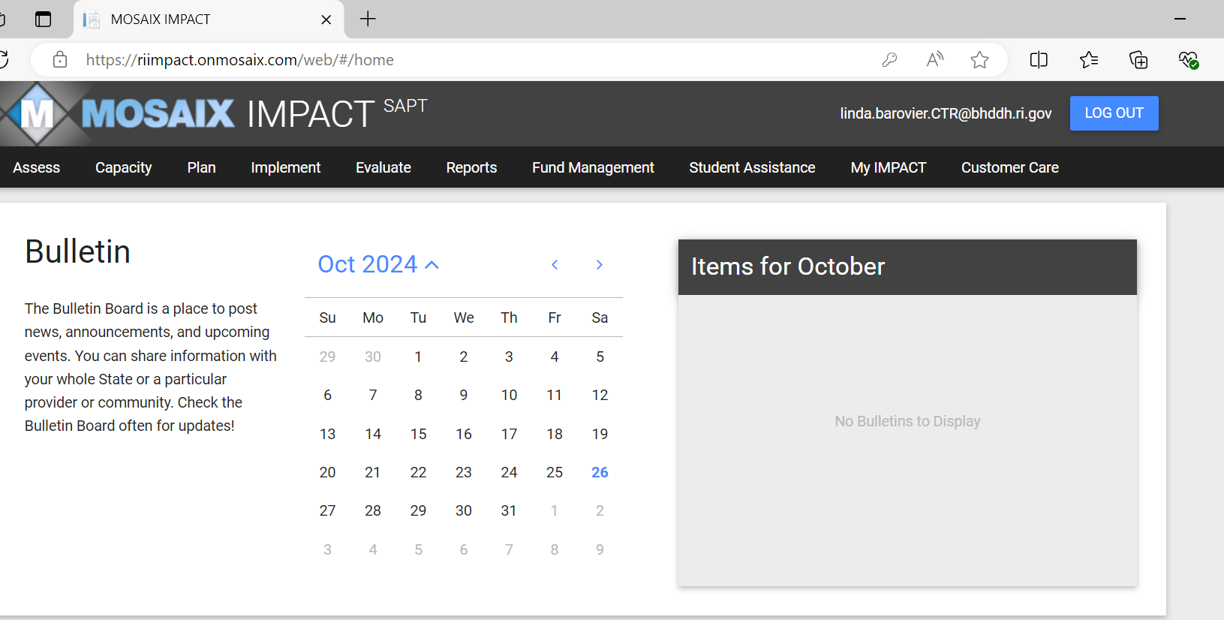
IMPACT Support Resources – Customer Care Ribbon
Navigate to Customer Care Ribbon for Resources
There are generic quick start guides (documents) and videos available in the IMPACT Customer Care ribbon. They are not specific to OSF or SOR but will help familiarize the user with the basics.

Slide 8
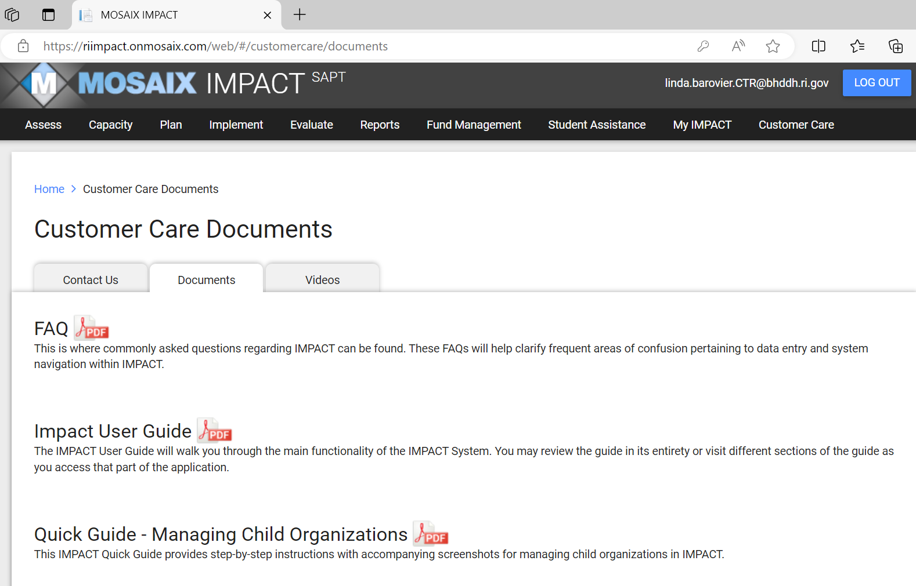
IMPACT Support Resources – Customer Care Ribbon
Navigate to Documents Tab
There are generic quick guides (documents). The following are recommended:
Frequently Asked Questions (FAQs) Impact_FAQ.pdf (onmosaix.com)
IMPACT^{SAPT} User Guide Version 1.0 Microsoft Word - IMPACT User Guide Version 1.0 (onmosaix.com)
IMPACT Record Recurring Services IMPACT Quick Guide to Recurring Services.pdf (onmosaix.com)
IMPACT Quick Guide to Navigating Reports Microsoft Word - Reports_step-by-step_20150904 (00000002) (onmosaix.com)

Slide 9
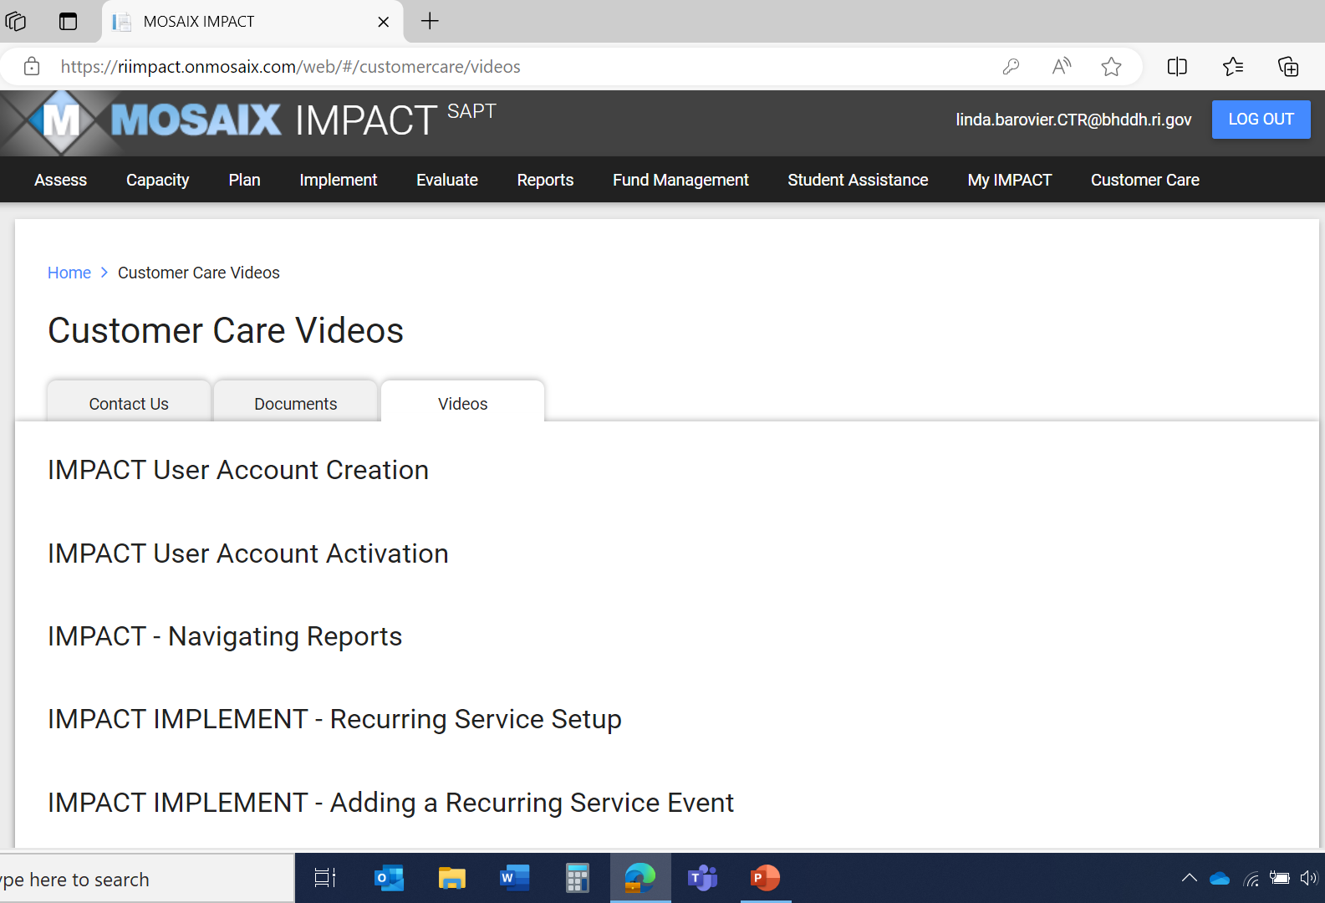
IMPACT Support Resources – Customer Care Ribbon
Navigate to Video Tab
There are You Tube videos that take the user through step by step. The following are recommended:
Navigating Reports
IMPLEMENT – Recurring Service Set Up
IMPLEMENT – Adding a Recurring Service Event

Slide 10
SOR and OSF Specifics
Orientation to the BHDDH Guidance document and overview of record creation

Slide 11
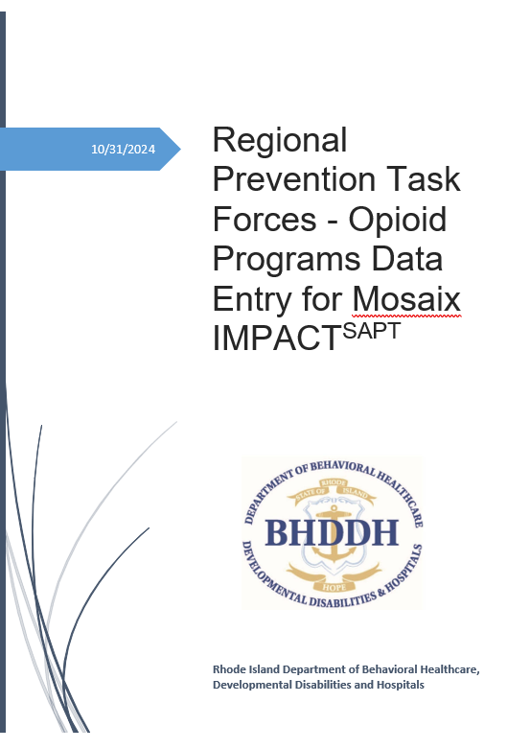
BHDDH Developed Guidance
This document covers
IMPACT basic navigation
Overview of record creation
Record or entry creations for OSF
  Naming conventions and why they are important
  Approved Programs and Interventions
Record or entry creations for SOR
  Naming conventions and why they are important
  Approved Programs and Interventions

Slide 12
Basic IMPACT Record Hierarchy & Structure
The specific structure will vary based on whether a program is treated as a recurring or a single service, but the basic structure is …
Goal
Objective
Program
Activity
Service

Slide 13
SOR4 and OSF 2025
Elements captured in IMPACT - instruction for how each is to be entered is contained in the BHDDH User Guide.
Programs
Programs
Activities
Different components of an intervention
Multiple implementation sites
Services
Recurring services
Single Services
Groups

Slide 14
SOR4 – Naming Conventions
Naming conventions are important because it helps to isolate programs by region and funding stream for reporting
Region Designation
  Use your specific regional prefix, for example, R1.
Funding Source Designation
  SOR4
Program Designation – the following programs and interventions are approved for implementation
    Drug Take Back Events
    Incredible Years
    In Shape
    Life of an Athlete/Substance Free Athletics
    Sidelined
    Strengthening Families
    Strong African American Families

Slide 15
SOR 4 Approved Programs
  Approved Programs and Interventions by Service Type
Programs and Interventions | Single Service | Recurring Service
Drug Take Back Events |  | X
Incredible Years |  | X
In Shape | X
Life of an Athlete/Substance Free Athletics | X
Raising Healthy Children |  | X
Sidelined | X
Strengthening Families |  | X
Strong African American Families |  | X

Slide 16
OSF 2025 – Naming Conventions
Naming conventions are important because it helps to isolate programs by region and funding stream for reporting
Region Designation
  Use your specific regional prefix, for example, R1.
Funding Source Designation
  OSF 2025 (you will use each contract year as part of the naming convention because OSF awards are annual
Program Designation – the following are approved for implementation
  Partnerships with BIPOC and Latinx Service Education Program (abbreviation BIPOC)
  Partnerships with Older Adult Service Provider Educational Program (abbreviation Senior Centers and High Rises).
  Naloxone trainings (stand alone, not as part of other programs)

Slide 17
OSF 2025 Approved Programs
  Approved Programs and Interventions by Service Type
Programs and Interventions | Single Service | Recurring Service
Senior Center & High-Rise Educational Programs | X
Bingocize |  | X
BIPOC Service Provider Educational Programs | X
Naloxone Trainings (as a stand-alone service). | X

Slide 18
IMPACT Reports
Data accuracy is important because data will be generated using IMPACT reports
Single Service by Program
Number Served
Recurring Service by Program
Number Served
Capacity Building Programs
Capacity Building

Slide 19
Contact: Elizabeth Trimmer Farrar
Associate Administrator
Prevention Coordinator
RI Department of Behavioral Healthcare, Developmental Disabilities & Hospitals
Division of Behavioral Healthcare
6 Harrington Road
Simpson Hall
Cranston, RI 02920
Email: Elizabeth.farrar@bhddh.ri.gov
Phone: 401-462-0644

